Slide 1
AAT TECH-TALK
MATHEMATICS
(AHSC02)
Roll No. : 21951A66A9
Presenter Name:
RISHIKESH PRADHAN
Branch: CSE(AI & ML)

Slide 2
TOPIC NAME:
DIAGONALIZATION OF A REAL SYMMETRICAL MATRIX

Slide 3
Eigen values and eigen vectors
Defination of Eigen Value and Eigen Vector:
Let A=[aij] be an nxn matrix. A non-zero vector X is said to be a characteristic vector of A if there exists a scalar λ Such that AX=λX
If AX=λX (X≠0), X is an Eigen Vector or characteristic vector of A corresponding to the Eigen value of A.
Prerequisite:
Rough

Slide 4

Let A and B be two matrices of order n. B can be considered similar to A if there exists an invertible matrix P such that
This is known as Matrix Similarity Transformation.
Matrix Diagonalization
Rough

Slide 5
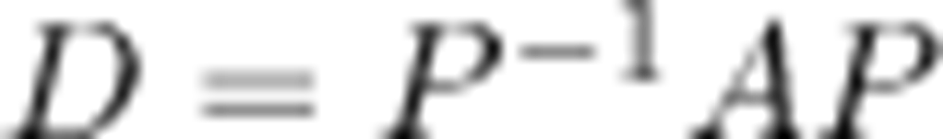
Diagonalization of a matrix is defined as the process of reducing any matrix A into its diagonal form D. As per the similarity transformation, if the matrix A is related to D, then and the matrix A is reduced to the diagonal matrix D through another matrix P. (P ≡ modal matrix)
Diagonalization of a matrix
Rough

Slide 6
Modal matrix: It is a (n x n) matrix that consists of eigen-vectors. It is generally used in the process of diagonalization and similarity transformation.
In simpler words, it is the process of taking a square matrix and converting it into a special type of matrix called a diagonal matrix.
Modal matrix
Rough

Slide 7
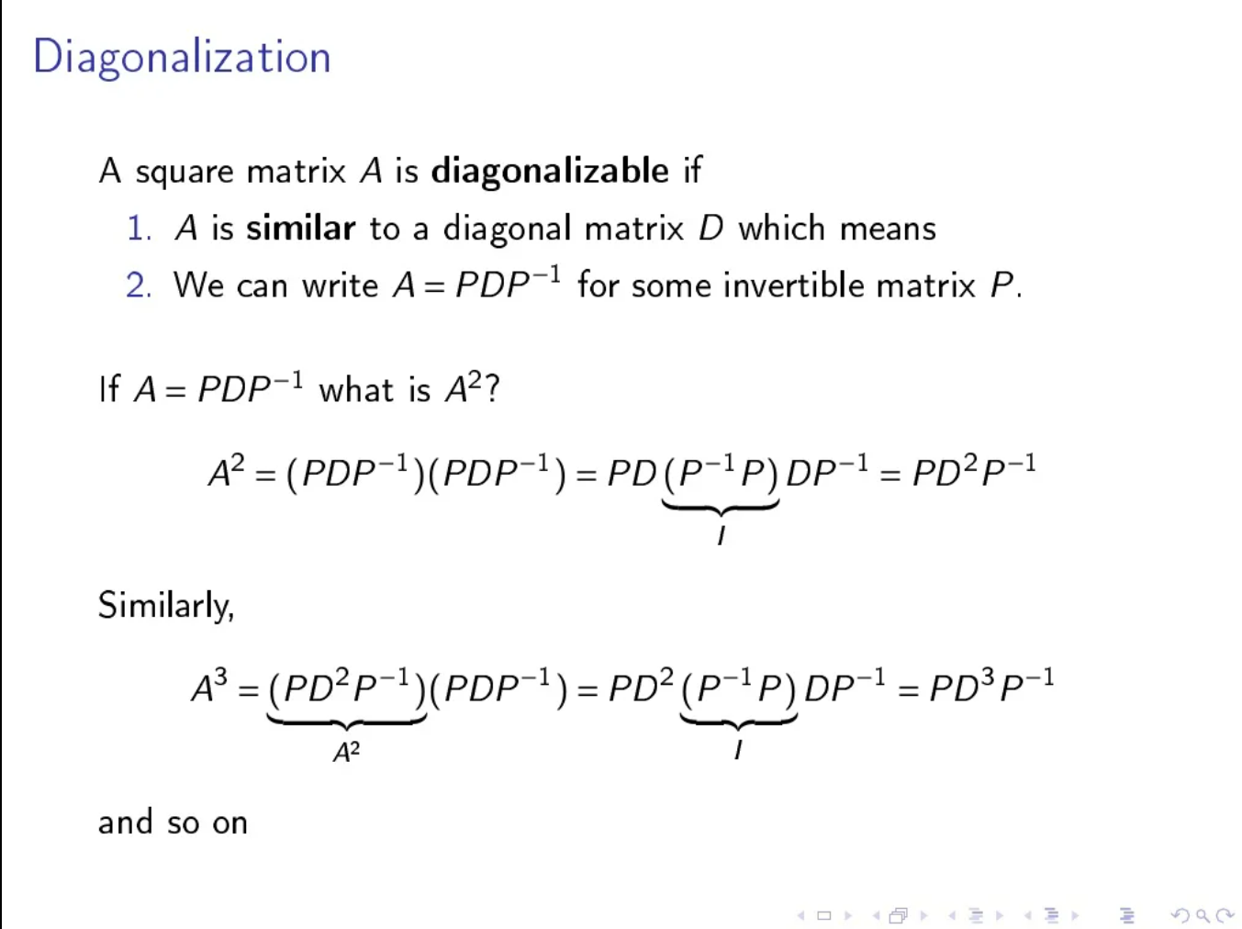
Rough

Slide 8
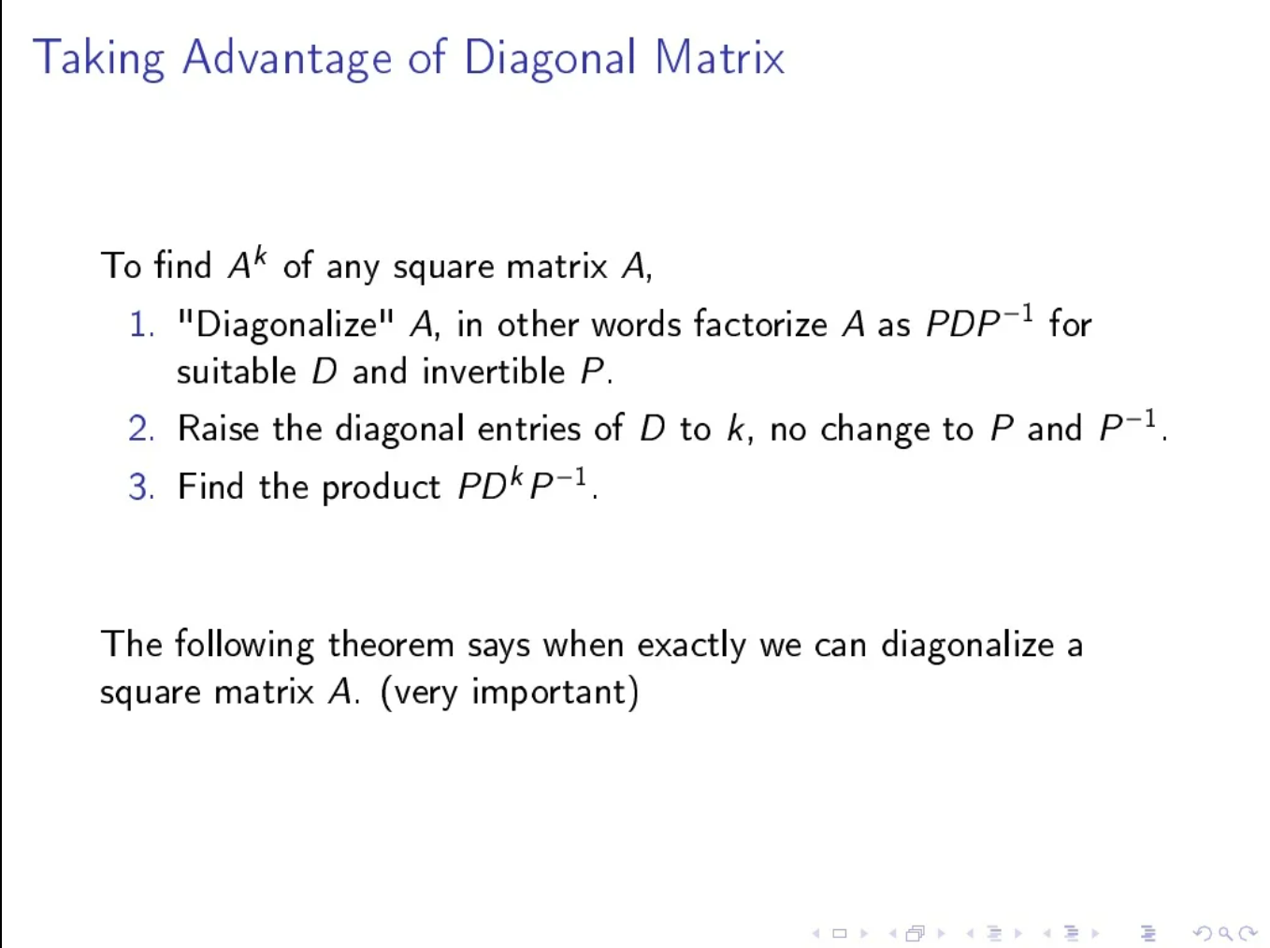
Rough

Slide 9
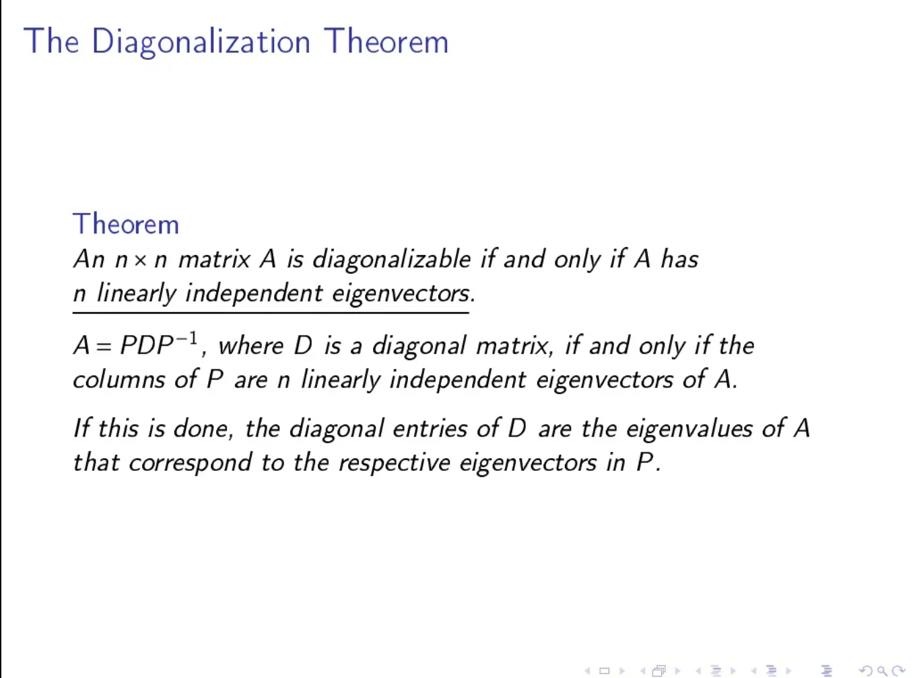
Rough

Slide 10
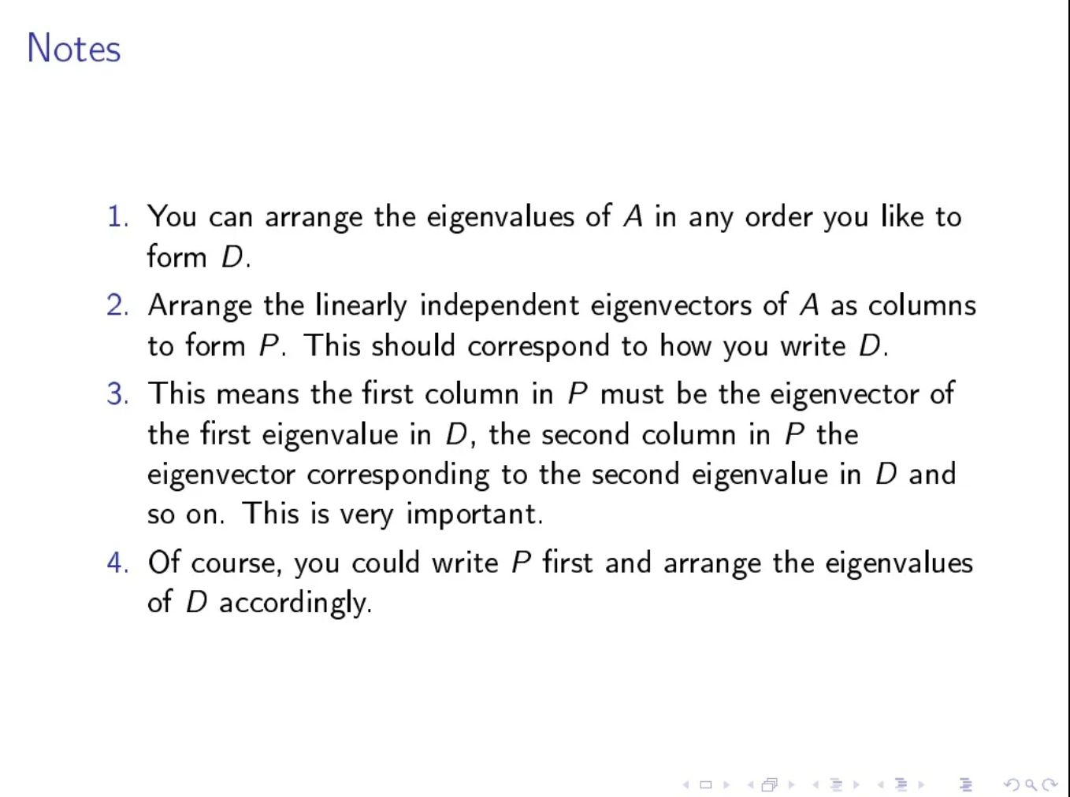
Rough

Slide 11
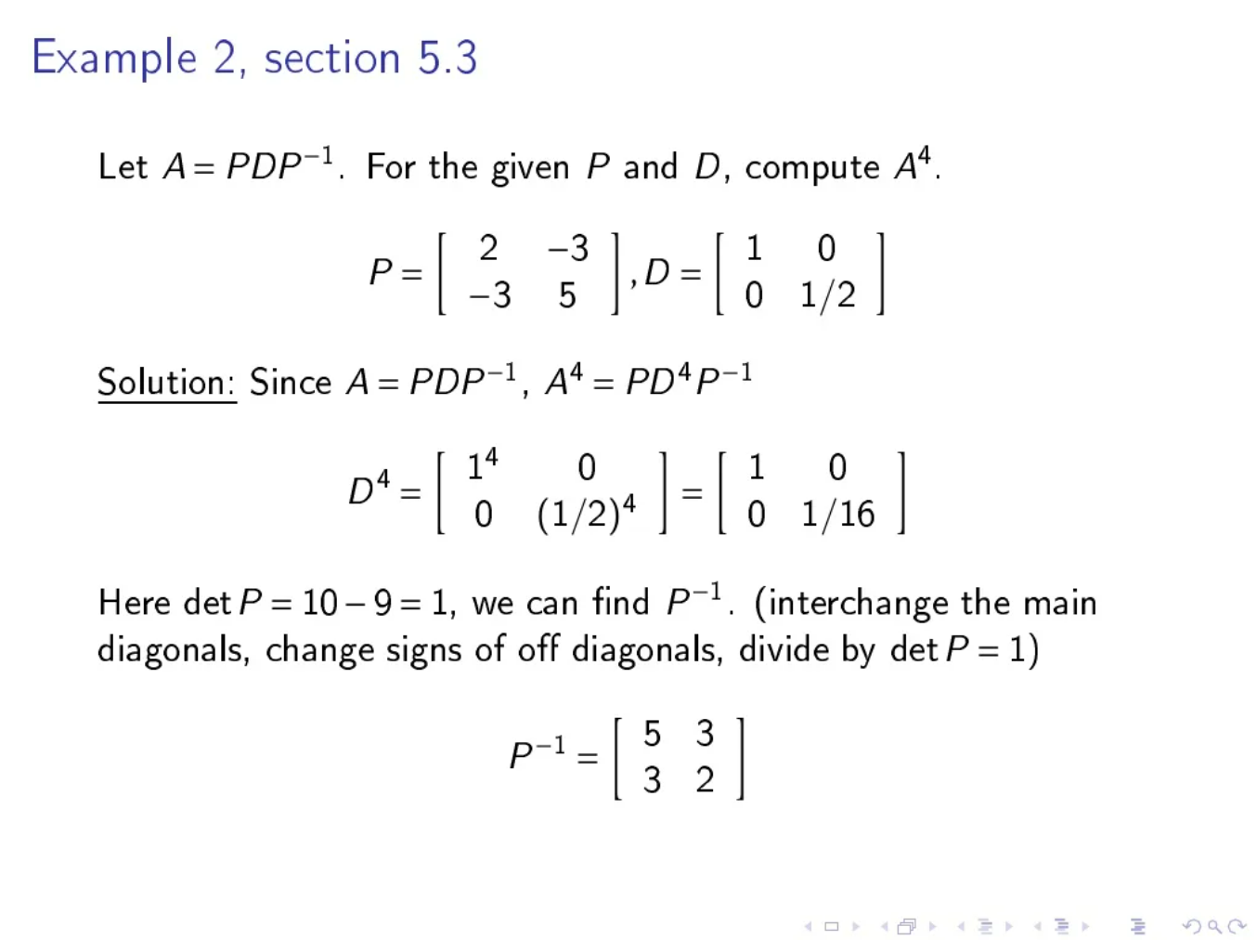
Rough

Slide 12
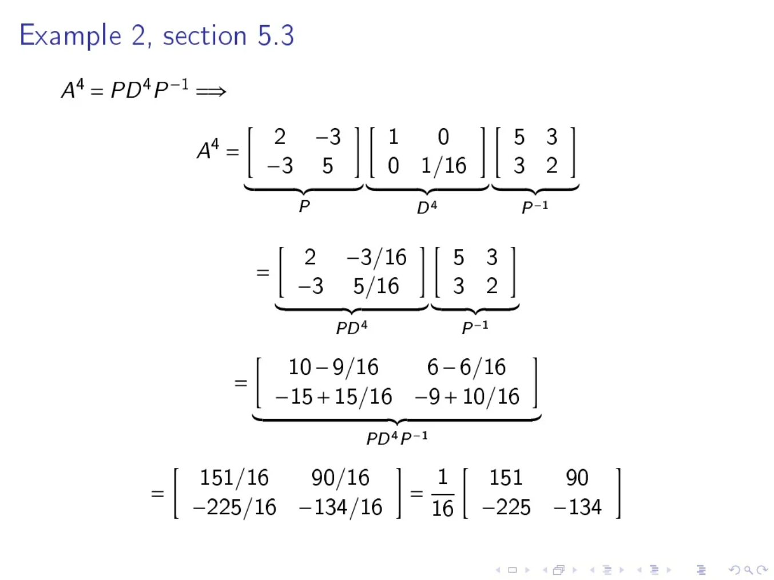
Rough

Slide 13

Step 1 - Initialize the diagonal matrix D as: where λ_{1, λ2, λ3 ->} eigen values
Steps Involved
Rough

Slide 14
Step 2 - Find the eigen values using the equation given below. where,
A -> given 3x3 square matrix.
I -> identity matrix of size 3x3. λ -> eigen value.
Steps Involved
Rough

Slide 15

Step 3 - Compute the corresponding eigen vectors using the equation given below. where, λ_{i ->} eigen value.
X_{i ->} corresponding eigen vector.
Steps Involved
Rough

Slide 16
Step 4 – Create the modal matrix P.
Here, all the aeigen vectors till X_{i} are filled column wise in matrix P.
Steps Involved
Rough

Slide 17
Step 5 - Find P⁻¹ and then use equation given below to find diagonal matrix D.
Steps Involved
Rough

Slide 18
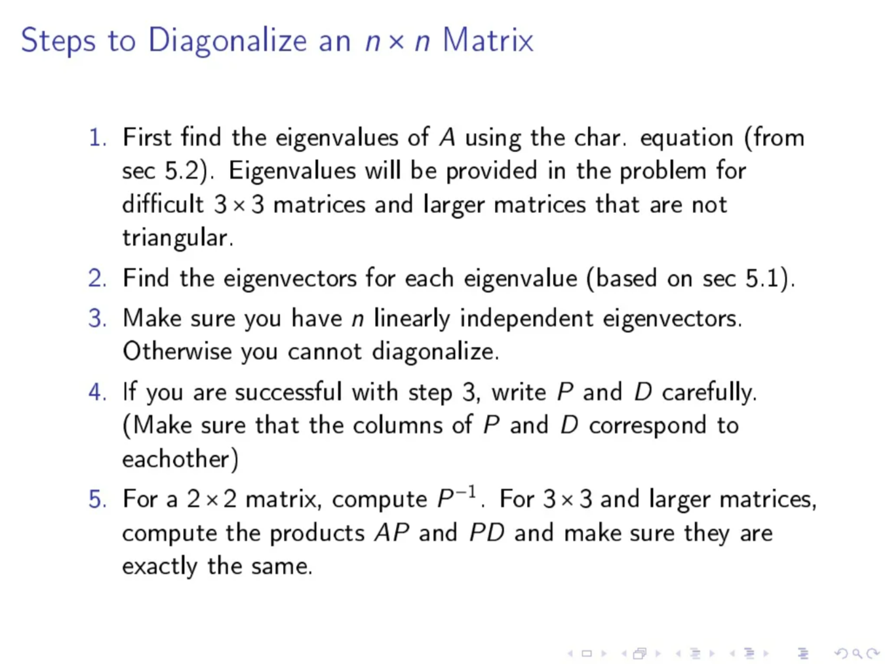
Rough

Slide 19
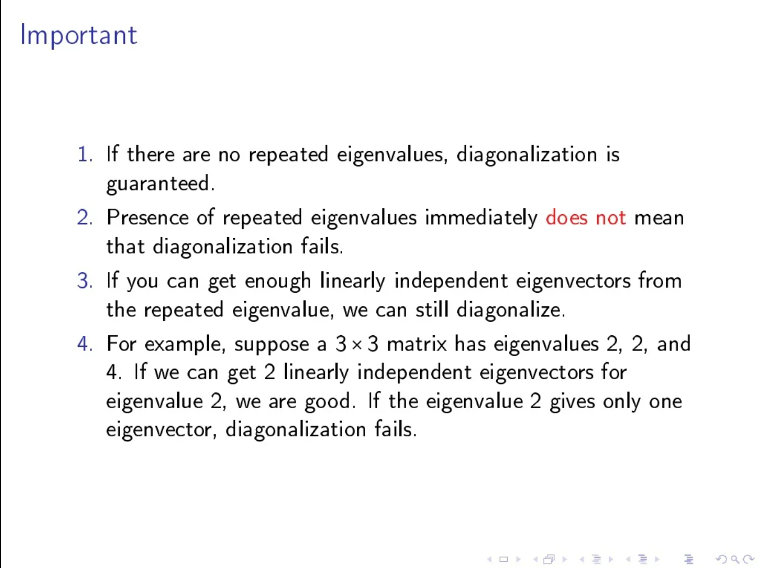
Rough

Slide 20
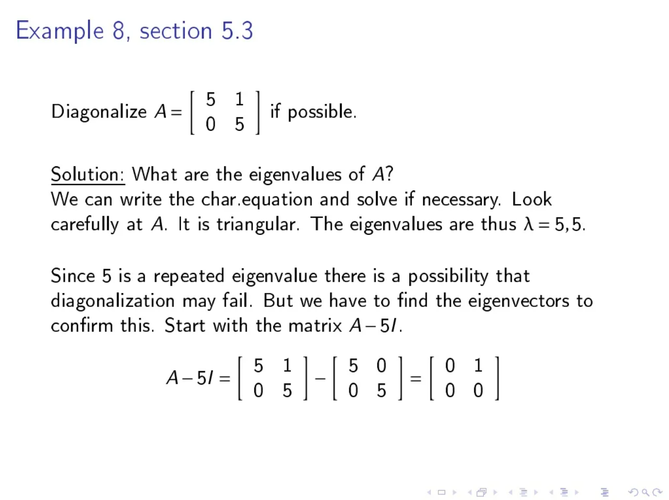
Rough

Slide 21
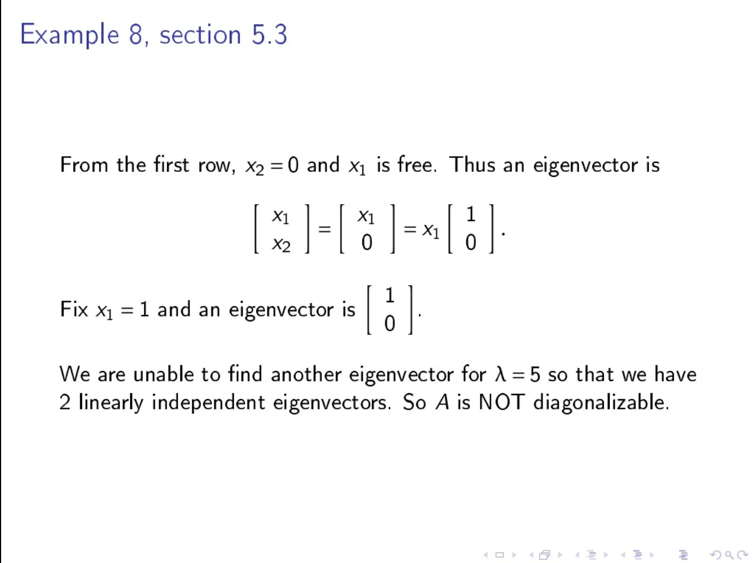
Rough

Slide 22
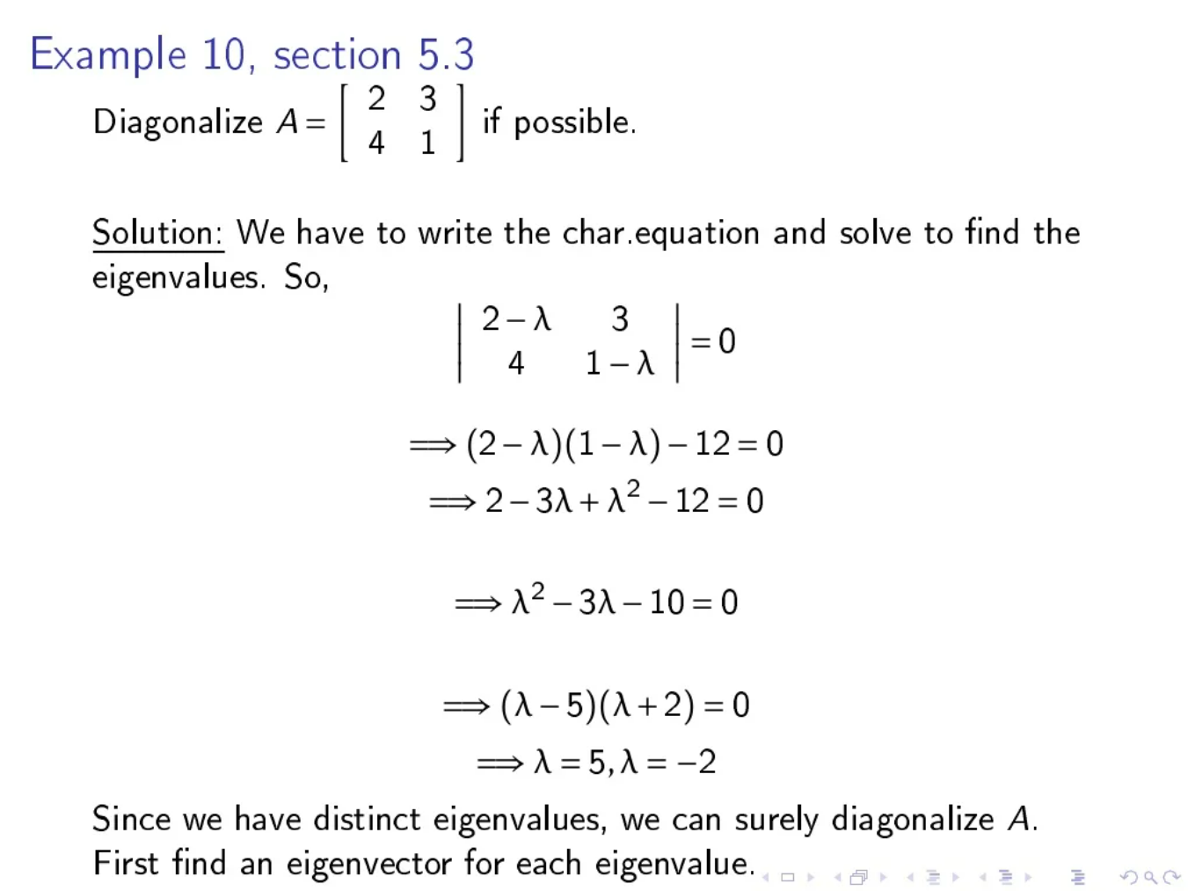
Rough

Slide 23
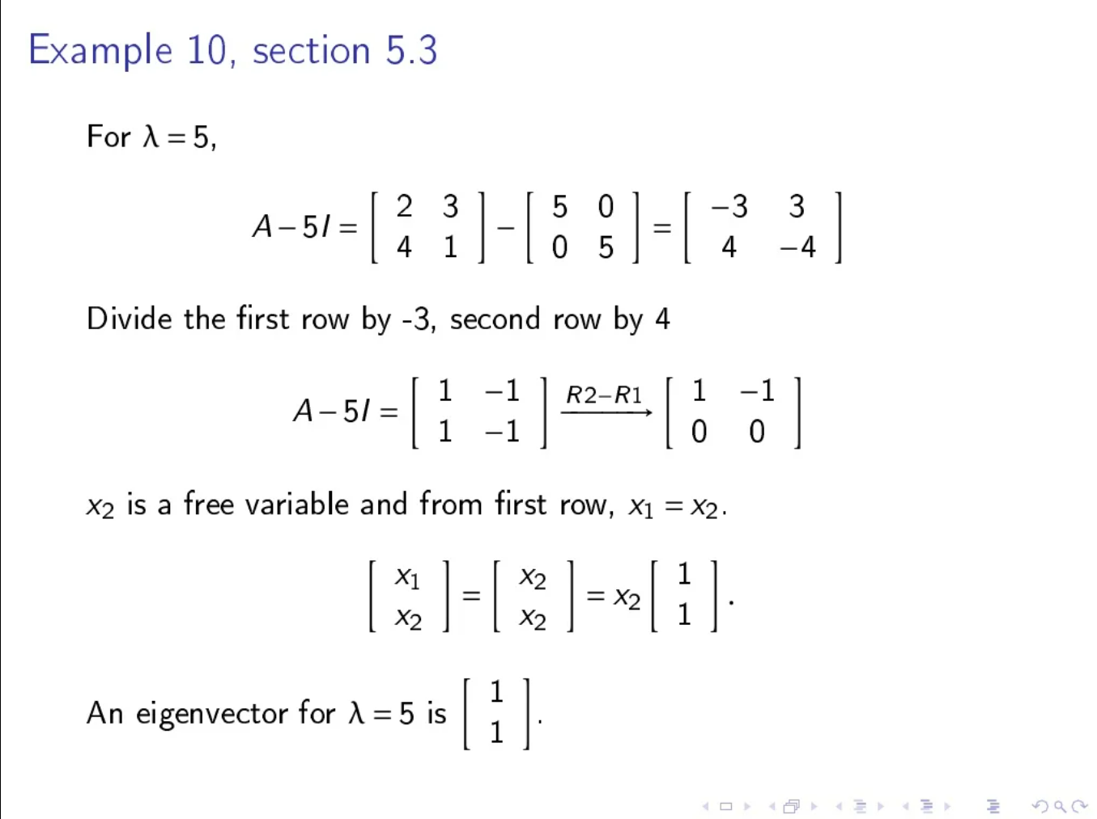
Rough

Slide 24
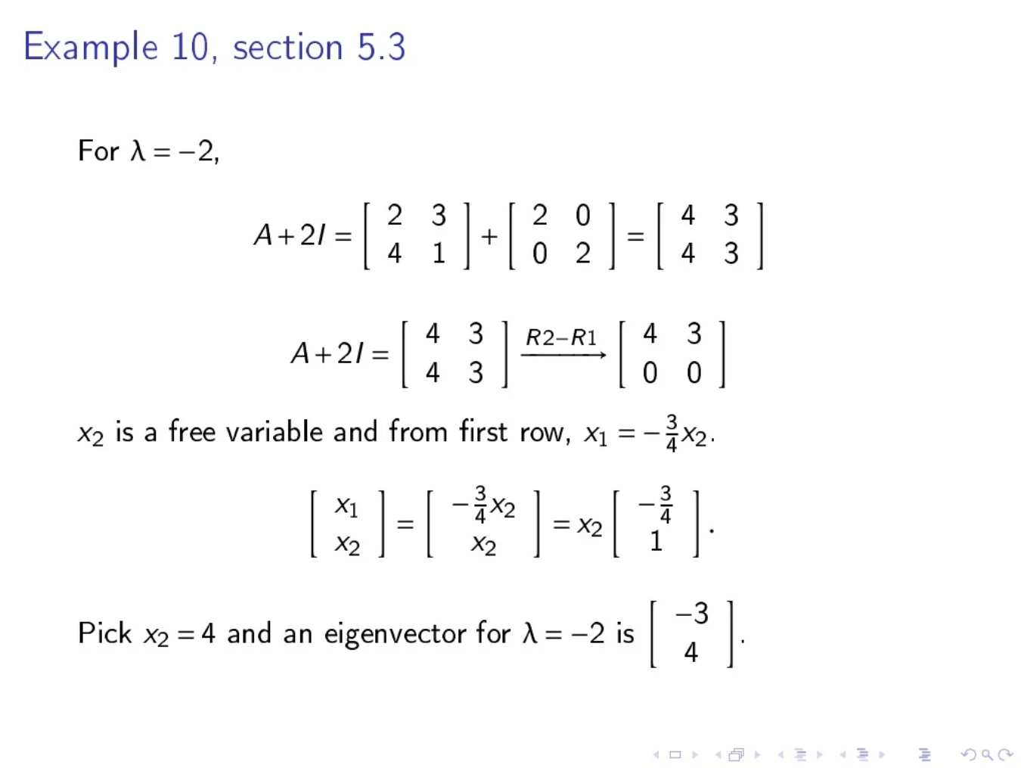
Rough

Slide 25
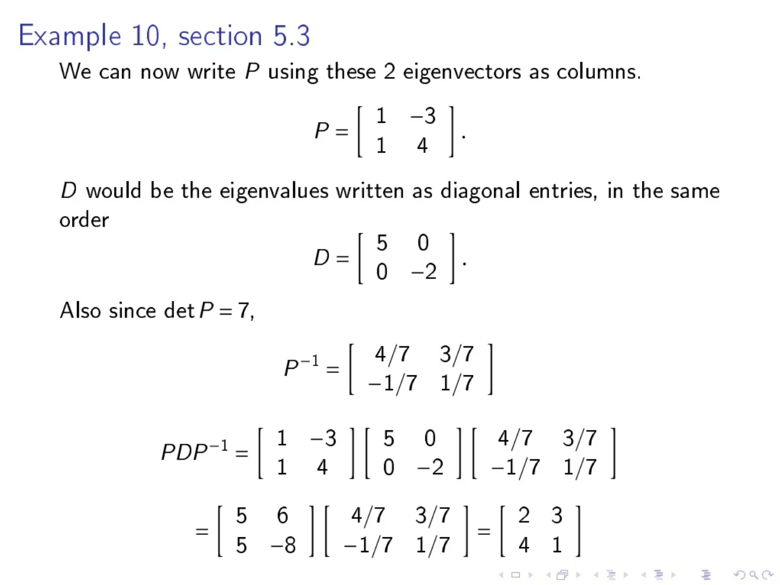
Rough

Slide 26

Problem Statement: Assume a 3×3 square matrix A having the following values:
Find the diagonal matrix D of A using the diagonalization of matrix. [ D = P⁻¹AP ]
Example Problem
Rough

Slide 27
Step 1 - Initializing D as:
Step by step solution:
Rough

Slide 28
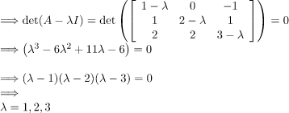
Step 2 - Find the eigen values.
(or possible values of λ)
Step by step solution:
Rough

Slide 29
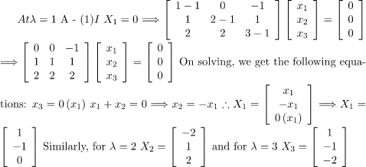
Step 3 - Find the eigen vectors X₁, X₂, X₃ corresponding to the eigen values λ = 1,2,3.
Step by step solution:
Rough

Slide 30

Step 4 - Creation of modal matrix P. (here, X₁, X₂, X₃ are column vectors)
Step by step solution:
Rough

Slide 31
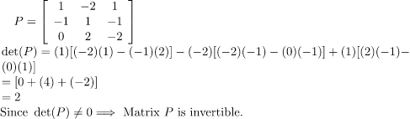
Step 5 - Finding P-1 and then putting values in diagonalization of a matrix equation.
[D = P-1AP]
We do Step 5 to find out which eigen value will replace λ1, λ2 and λ3 in the initial diagonal matrix created in Step 1.
Step by step solution:
Rough

Slide 32

We know that
On solving, we get
Step by step solution:
Rough

Slide 33
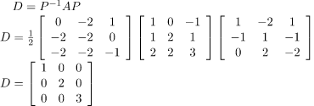
Putting in Diagonalization of Matrix equation, we get
Step by step solution:
Rough

Slide 34
Roll No. : 21951A66A9
Presenter Name:
RISHIKESH PRADHAN
Branch: CSE(AI & ML)
THANK YOU

